Slide 1
Overlapping (blended) shooting with dithers:
How to do better than a “random sequence”….
Thomas Elboth (telboth@shearwatergeo.com) – April 2021

Slide 2
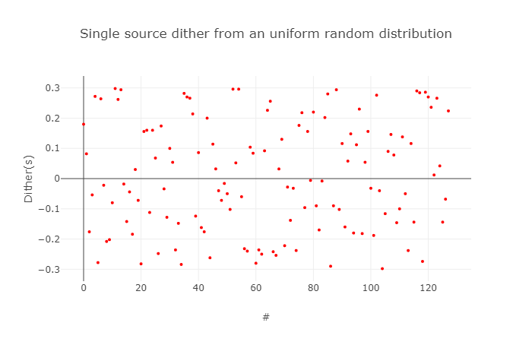
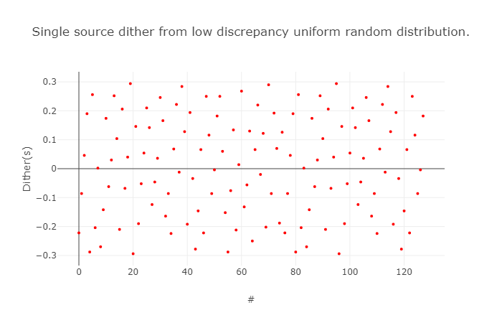
Assumption about dithering
Random is perhaps
“too much” random.
We get natural
“clustering”
An ideal dithering sequence for deblending is:
Uniform random
Meaning that all values have the same likelihood. (the histogram is reasonably flat)
The normal ‘rand()’ function on a computer will give such a sequence.
Low discrepancy
Meaning that values are well distributed – and not clustered.
This means that we need to put additional constraints on the dithering sequence.
Low discrepancy
random seems
intuitively
better…

Slide 3
Dithering in practice: Observations:
Dither all shot-times (from Sources S1, S2 and S3) by [0-x] ms.
Sort to common-offset for deblending
When we align for S1, S2 and S3 will be distributed over [-x to x]ms
When we align for S2, S1 and S3 will be distributed over [-x to x]ms
When we align for S3, S2 and S1 will be distributed over [-x to x]ms
Shot number
S1(i)
S2(i)
Time
S3(i)
S1(i)-S1(i)
S2(i)-S1(i)
S3(i)-S1(i)
S1(i)-S2(i)
S2(i)-S2(i)
S3(i)-S2(i)
S1(i+1)-S3(i)
S2(i+1)-S3(i)
S3(i)-S3(i)
→Key observation:
When aligning the shot times for source N the effective dithers from source N+1 becomes the sum (difference) of the dithers from source N and N+1. We want the effective dither (S2-S1) to be uniform random – and low discrepancy.

Slide 4
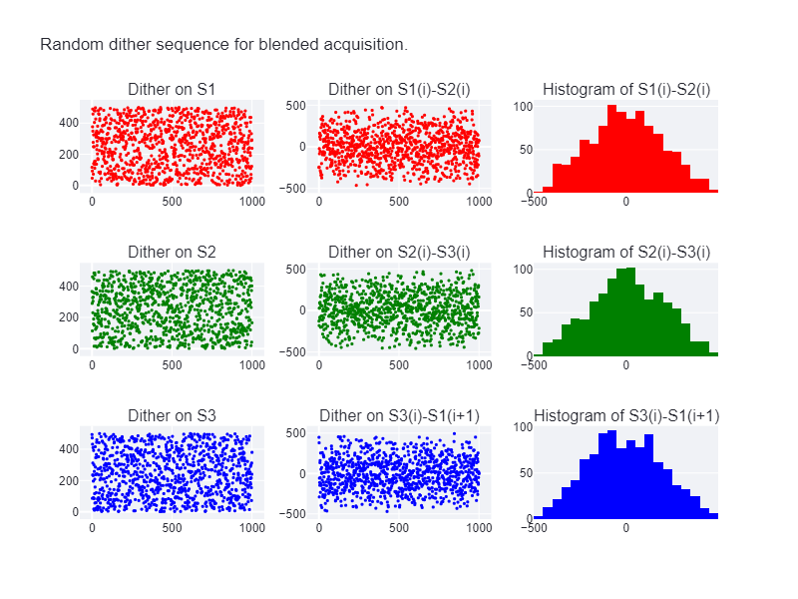
Using random dithers
Adding two uniform random
sequences gives a triangular
distribution (Irwin-Hall).
The result is also high
discrepancy
That is clearly NOT ideal!

Slide 5
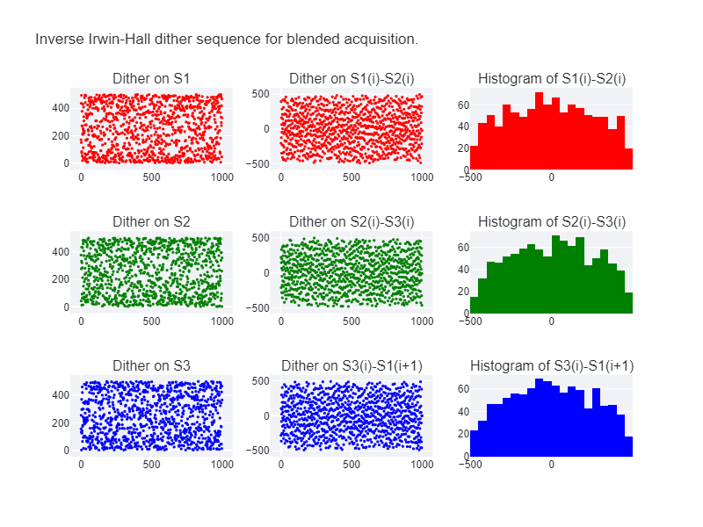
By doing some math-magic (inspired by, but not a copy of Patent US10649108): Low discrepancy – Inverse Irwin-Hall
The key idea is that the effective dithers are the sum of the dithers from two sources.
These effective dithers should ideally be low discrepancy – and close to uniform random.
Adjusted functionality is available at:
https://acqplotter-web-app.azurewebsites.net/
Inverse Irwin-Hall.
Notice clustering at
the edges…
Low discrepancy
Not 100% uniform random,
but close!

